Slide 1
Improve this poster regarding the 4 design principles
TOW-AWAY
TEMPORARY
Create a A4 (portrait) frame on FIGMA
What are the problems on this design ?
Discuss in team
You can change only :
MARGINS, SPACES, ALIGNMENTS, GRID
TEXT FONTS & SIZES
BACKGROUND, TEXT COLORS
ICONS
3 Complete the table bellow to explain your improvements on design principles
NO PARKING
ANYTIME
SUNDAY ONLY
8 AM - 6 PM
VIOLATORS WILL BE TOWED

Slide 2
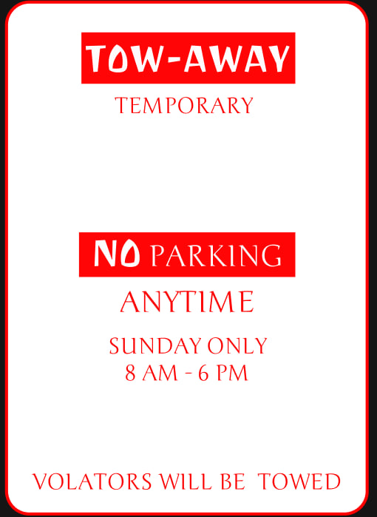

Slide 3
Complete the table bellow to explain your improvements on design principles :
Proximity | Yes, because we have three group to use space.
Alignment | Yes, align center
Contrast | Yes, the place that contrast are Tow-away and No parking
Repetition | Yes, repetition font, size and color

